Slide 1
Grupo bimbo inventory demand & extra trees classifier
Alex Fang
Vinnie Liu

Slide 2
The Company
the world’s largest baking company
the widest distribution networks in the world
operates more than 100 trademarks
including Sara Lee, Wonder, Oroweat
scheme of recurrent sales channel views
Notes:
One of the widest distn -Surpassing 52,000 routes
Operates the largest bakeries in the US, Mexico, Canada and Spain
Bimbo operates under a scheme of recurrent sales channels views, making three daily visits to the same establishment.

Slide 3
The ComPETITION
stores must meet daily consumer demand in over 1 million stores across Mexico
current projections performed by sales employees based on personal experiences with each store
implications: shelf-life of bread
small acceptable margin for error
Notes:
to meet daily consumer demand for fresh bakery products on the shelves of over 1 million stores along its 45,000 routes across Mexico
Currently, daily inventory calculations are performed by direct delivery sales employees who must single-handedly predict the forces of supply, demand, and hunger based on their personal experiences with each store. With some breads carrying a one week shelf life, the acceptable margin for error is small.

Slide 4
The ComPETITION
Kagglers invited to develop a model to forecast inventory demand
Based on historical sales data
Objective: to simultaneously ensure consumers needs are met and to minimize product returns to store owners
Notes:
In this competition, Grupo Bimbo invites Kagglers to develop a model to accurately forecast inventory demand based on historical sales data. Doing so will make sure consumers of its over 100 bakery products aren’t staring at empty shelves, while also reducing the amount spent on refunds to store owners with surplus product unfit for sale.

Slide 5
The DATA
DATA FILES
Notes:
In this competition, you will forecast the demand of a product for a given week, at a particular store. The dataset you are given consists of 9 weeks of sales transactions in Mexico. Every week, there are delivery trucks that deliver products to the vendors. Each transaction consists of sales and returns. Returns are the products that are unsold and expired. The train and test dataset are split based on time
Train- 74 million obs
Test- 7 million obs

Slide 6
The DATA
DATA FIELDS
Notes:
The demand for a product in a certain week is defined as the sales this week subtracted by the return next week.

Slide 7
The evaluation Metric
Notes:
Where:
\\(\epsilon\\) is the RMSLE value (score) \\(n\\) is the total number of observations in the (public/private) data set, \\(p_i\\) is your prediction of demand, and \\(a_i\\) is the actual demand for \\(i\\). \\(\log(x)\\) is the natural logarithm of \\(x\\)

Slide 8
The WINNER
Notes:
We built a lot of models on 1st level (using 9 week as validation set) The training method of most of 1st level models was XGBoost. For second level we used ExtraTrees classifier and linear model from Python scikit-learn. The final result is weighted average of these two models.

Slide 9
The METHOD
ENSEMBLE LEARNING
Combining a diverse set of learners to improve on the stability and predictive power of the model
Top 4 reasons models are different:
Population
Hypothesis
Modeling technique
Initial seed
Notes:
Ensemble is the art of combining diverse set of learners (individual models) together to improvise on the stability and predictive power of the model. In the above example, the way we combine all the predictions together will be termed as Ensemble Learning.
In this article, we will talk about a few ensemble techniques widely used in the industry. Before we get into techniques, let’s first understand how do we actually get different set of learners. Models can be different from each other for a variety of reasons, starting from the population they are built upon to the modeling used for building the model.

Slide 10
An example
ENSEMBLE LEARNING
Investing in a company:
Notes:
Example: I want to invest in a company XYZ. I am not sure about its performance though. So, I look for advice on whether the stock price will increase more than 6% per annum or not? I decide to approach various experts having diverse domain experience:
Given the broad spectrum of access we have, we can probably combine all the information and make an informed decision.
Assumption: The assumption used here that all the predictions are completely independent is slightly extreme as they are expected to be correlated. However, we see how we can be so sure by combining various predictions together.

Slide 11
The METHOD
ENSEMBLE LEARNING
Notes:
The error emerging from any model can be broken down into three components mathematically. Following are these component :
Why is this important in the current context? To understand what really goes behind an ensemble model, we need to first understand what causes error in the model. We will briefly introduce you to these errors and give an insight to each ensemble learner in this regards.

Slide 12
The METHOD
ENSEMBLE LEARNING
Bias:
How predicted values differ from actual values
Variance:
how predictions made on the same obs. differ from each other
Notes:
Bias error is useful to quantify how much on an average are the predicted values different from the actual value. A high bias error means we have a under-performing model which keeps on missing important trends.
Variance on the other side quantifies how are the prediction made on same observation different from each other. A high variance model will over-fit on your training population and perform badly on any observation beyond training. Following diagram will give you more clarity (Assume that red spot is the real value and blue dots are predictions) :

Slide 13
The METHOD
ENSEMBLE LEARNING
Trade- off management
Increase in complexity results in error reduction
lower bias
Continuing complexity results in over-fitting
Higher variance
Notes:
Normally, as you increase the complexity of your model, you will see a reduction in error due to lower bias in the model. However, this only happens till a particular point. As you continue to make your model more complex, you end up over-fitting your model and hence your model will start suffering from high variance.
A champion model should maintain a balance between these two types of errors. This is known as the trade-off management of bias-variance errors. Ensemble learning is one way to execute this trade off analysis.

Slide 14
The METHOD
ENSEMBLE LEARNING
Common Methods
1. Bagging
2. Boosting
3. Stacking
Notes:
Bagging : Bagging tries to implement similar learners on small sample populations and then takes a mean of all the predictions. In generalized bagging, you can use different learners on different population. As you can expect this helps us to reduce the variance error.
Boosting : Boosting is an iterative technique which adjust the weight of an observation based on the last classification. If an observation was classified incorrectly, it tries to increase the weight of this observation and vice versa. Boosting in general decreases the bias error and builds strong predictive models. However, they may sometimes over fit on the training data.
Stacking : This is a very interesting way of combining models. Here we use a learner to combine output from different learners. This can lead to decrease in either bias or variance error depending on the combining learner we use.

Slide 15
The METHOD
ENSEMBLE LEARNING
Common Methods
1. Bagging
2. Boosting
3. Stacking
Notes:
Bagging : Bagging tries to implement similar learners on small sample populations and then takes a mean of all the predictions. In generalized bagging, you can use different learners on different population. As you can expect this helps us to reduce the variance error.
Boosting : Boosting is an iterative technique which adjust the weight of an observation based on the last classification. If an observation was classified incorrectly, it tries to increase the weight of this observation and vice versa. Boosting in general decreases the bias error and builds strong predictive models. However, they may sometimes over fit on the training data.
Stacking : This is a very interesting way of combining models. Here we use a learner to combine output from different learners. This can lead to decrease in either bias or variance error depending on the combining learner we use.

Slide 16
The METHOD
EXTRA TREES CLASSIFIER
Question:
Can we further improve accuracy with respect to existing ensemble methods by increasing randomization levels?

Slide 17
The METHOD
EXTRA TREES CLASSIFIER
Question:
Can we further improve accuracy with respect to existing ensemble methods by increasing randomization levels?
existing randomization methods significantly randomize the standard tree-growing algorithm
still far from building totally random trees
high variance of decision and regression tree splits suggests higher randomization levels could improve accuracy with respect to existing ensemble methods
Notes:
Although existing randomization methods for trees significantly randomize the standard tree growing algorithm, they are still far from building totally random trees, and the high variance of decision and regression tree splits suggests that higher randomization levels could improve accuracy with respect to existing ensemble methods

Slide 18
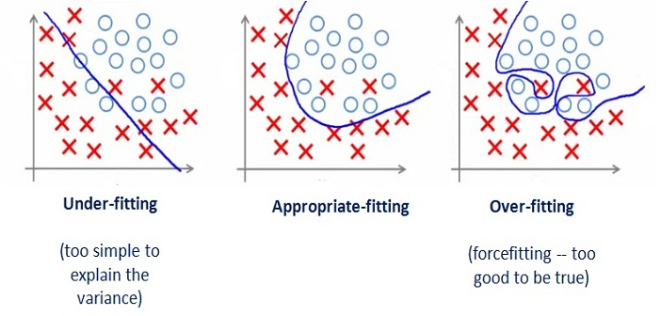
The METHOD
EXTRA TREES CLASSIFIER
implements a meta estimator
fits a number of randomized decision trees (a.k.a. extra-trees) on various sub-samples of the dataset
uses averaging to improve the predictive accuracy and control over-fitting
Notes:
What is an extra-trees classifier?
This class implements a meta estimator that fits a number of randomized decision trees (a.k.a. extra-trees) on various sub-samples of the dataset and use averaging to improve the predictive accuracy and control over-fitting.

Slide 19
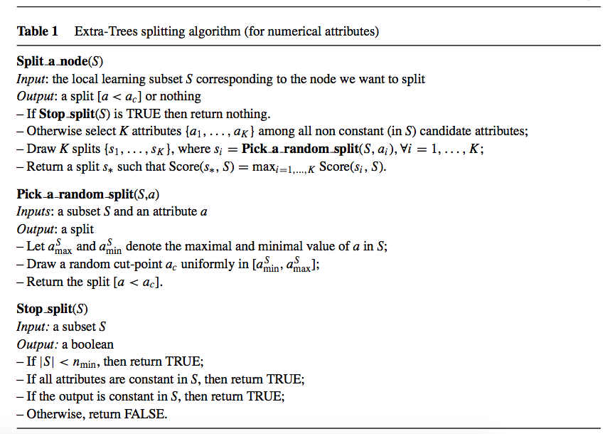
How it works?
EXTRA TREES CLASSIFIER
Notes:
How does this classifier work?
The Extra-Trees splitting procedure for numerical attributes is given in Table 1.1 It has two parameters: K, the number of attributes randomly selected at each node and Nmin, the minimum sample size for splitting a node. It is used several times with the (full) original learning sample to generate an ensemble model (we denote by M the number of trees of this ensemble). The predictions of the trees are aggregated to yield the final prediction, by majority vote in classification problems and arithmetic average in regression problems.

Slide 20
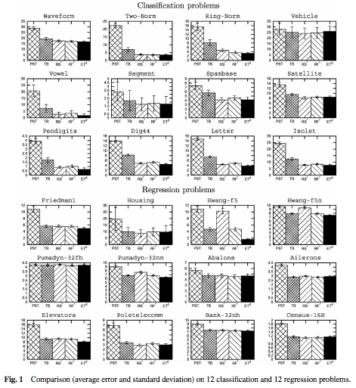
An Example
EXTRA TREES CLASSIFIER
All algorithms were run on the learning sample and their errors were estimated on the test sample (10x on each dataset)
Fig. 1 Comparison (average error and standard deviation on 12 classification and 12 regression problems.
Notes:
The winner greatly talked about how they used ExtraTree method in the forum but they wrote it on python, we will instead use another example we found in a published paper. We have a list of algorithms and all algorithms were run on the learning sample and their errors were estimated on the test sample. This figure shows the average and standard deviations of the errors of each method obtained on each dataset. In classification problems these numbers refer to error rates in percent, whereas in regression problems they refer to mean square-errors, multiplied by a factor given in a table also in the paper
(In this figure, pruned single cart tree is to very left, and Extra-Tree method is to very right (black bar), and we also have Tree Bagging, Random Subspace and Random Forest in the middle. )

Slide 21
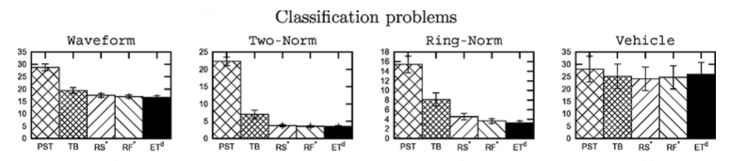
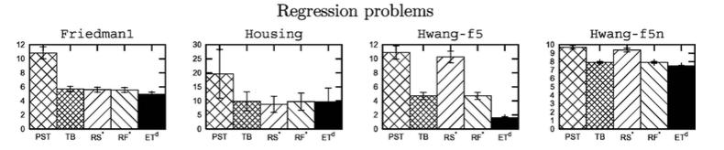
example
EXTRA TREES CLASSIFIER
Notes:
Concerning average accuracies, Fig. 1 highlights that on a very large majority of problems Extra-Trees are as accurate or more accurate than the other ensemble methods. Among these other methods, Tree Bagging is less convincing on classification problems, while on regression problems it appears to be equivalent with the Random Forests. Overall, the Extra-Tree works very well

Slide 22
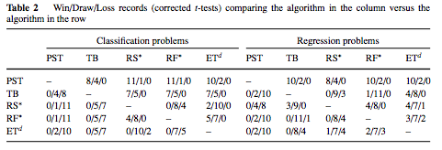
example
EXTRA TREES CLASSIFIER
Notice that Extra-Trees never lose on classification problems.
Notes:
They also performed statistical tests to compare the different algorithms. For this purpose, they used a corrected paired two-sided t-test with a confidence level of 95%. This table reports on the “Win-Draw-Loss” statuses of all pairs of methods.
Let’s look at this table, the records comparing the algorithm in the column versus the algorithm in the row,
We noticed that Extra-Trees never lose on classification problems
whereas, the Tree Bagging loses 7 times with respect to the other ensemble methods on classification problems

Slide 23
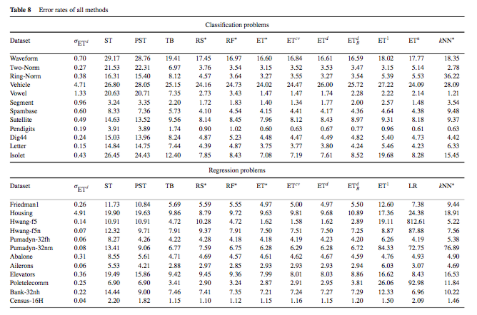
CROSS VALIDATION
EXTRA TREES CLASSIFIER
Notes:
We also found a table of error rate in the paper with respect to method we just mentioned. We noticed that errors for ExtraTree were relatively lower than RS, and RF

Slide 24
The METHOD
EXTRA TREES CLASSIFIER
Conclusion
Notes:
From the bias-variance point of view, the rationale behind the Extra-Trees method is that the explicit randomization of the cut-point and attribute combined with ensemble averaging should be able to reduce variance more strongly than the weaker randomization schemes used by other methods.

Slide 25
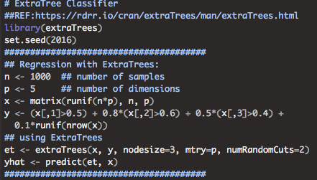
The METHOD
EXTRA TREES CLASSIFIER
A simulation

Slide 26
REFERENCES
https://en.wikipedia.org/wiki/Grupo_Bimbo
http://stackoverflow.com/questions/20177970/decisiontreeclassifier-vs-extratreeclassifier
http://stackoverflow.com/questions/22409855/randomforestclassifier-vs-extratreesclassifier-in-scikit-learn
http://orbi.ulg.ac.be/bitstream/2268/9357/1/geurts-mlj-advance.pdf
https://www.analyticsvidhya.com/blog/2015/08/introduction-ensemble-learning/
http://scikit-learn.org/stable/modules/generated/sklearn.ensemble.ExtraTreesClassifier.html
P. Geurts, D. Ernst., and L. Wehenkel, “Extremely randomized trees”, Machine Learning, 63(1), 3-42, 2006
Example was retrieved from: https://rdrr.io/cran/extraTrees/man/extraTrees.html

Slide 27
Thank you!

